Slide 1

Easy Survey
Members:
Kayleigh Moore – 301135257
Parth Sharma– 301250690
Tsang Tsz Long– 301206736
Helena Zare – 301178546
Yang Xuan – 301186289
Arsalaan Siddiqui– 301212179
COMP 229 22F --Web Application Development
Type of project: Survey Forms Application
Notes:
https://cloud.mongodb.com/v2/636d0d2520d33e3f015532e9#clusters
https://github.com/beyuneek/Comp229_Sec004_GroupProject_Group_4
https://trello.com/b/TQdU9mGZ/comp229004group4
https://youtu.be/o0aaiKfouG0

Slide 2
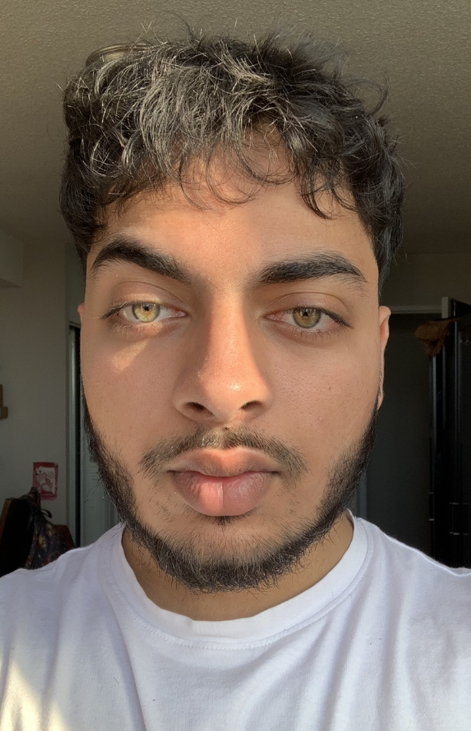
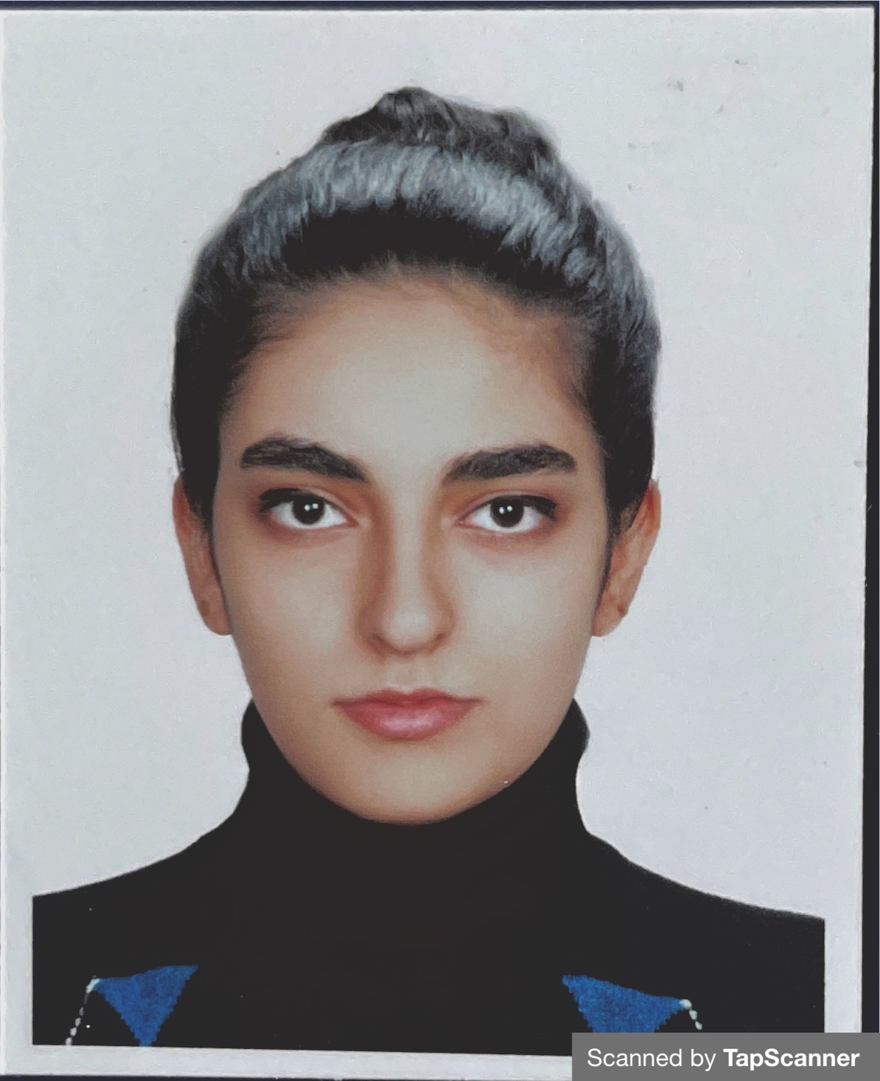
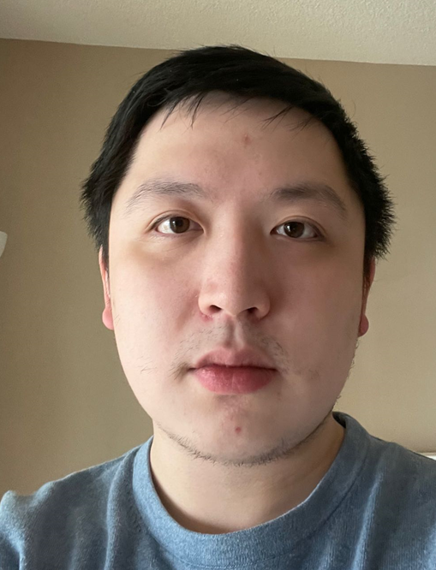
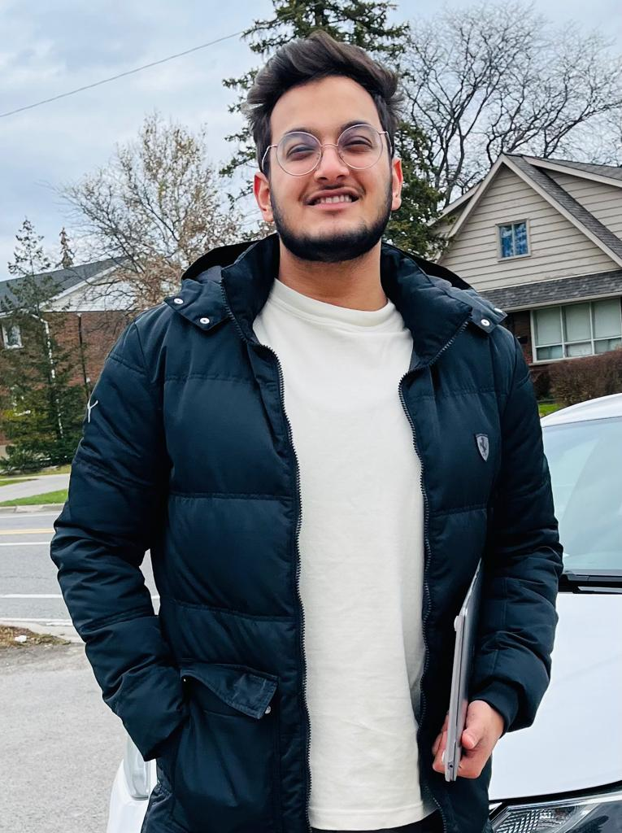
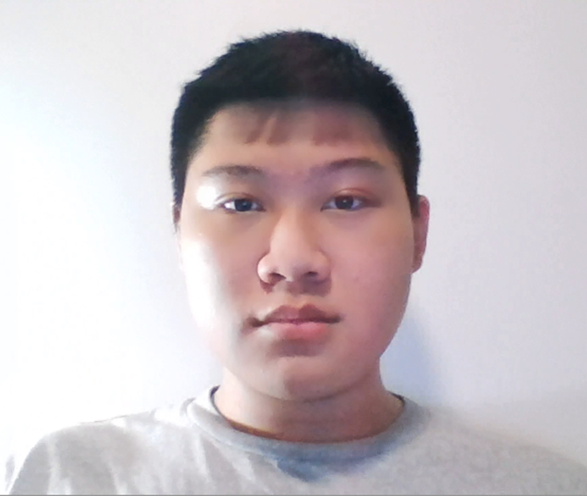
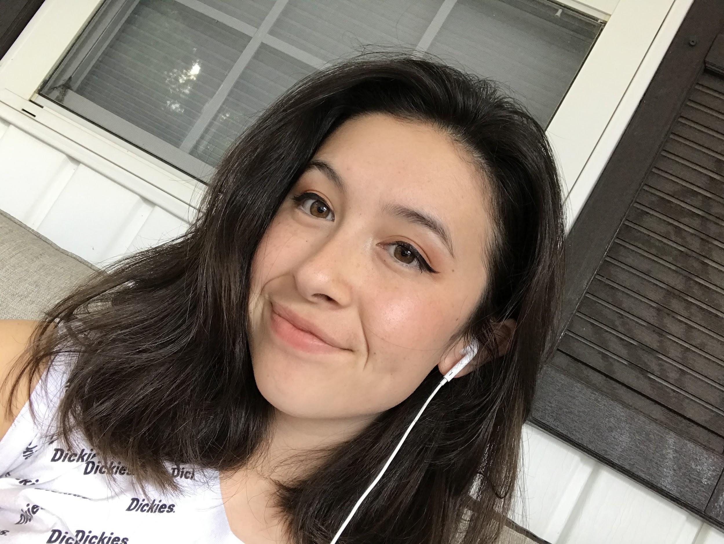
Helena Zare – 301178546
Web Designer
Arsalaan Siddiqui– 301212179
Web Designer
Yang Xuan
ID: 301186289
Security Programmer
Parth Sharma
ID:301250690
Web Designer
Database Programmer
Lead Software Engineer
Tsang tsz long
ID:301206736
UI Programmer
Kayleigh Moore
ID: 301135257
Web Designer

